Slide 1


Slide 2

The Gospel of Matthew

Slide 3
Matthew 28:18-20
18 Then Jesus came to them and said, “All authority in heaven and on earth has been given to me. 19 Therefore go and make disciples of all nations, baptizing them in the name of the Father and of the Son and of the Holy Spirit, 20 and teaching them to obey everything I have commanded you. And surely
I am with you always,
to the very end of the age.

Slide 4
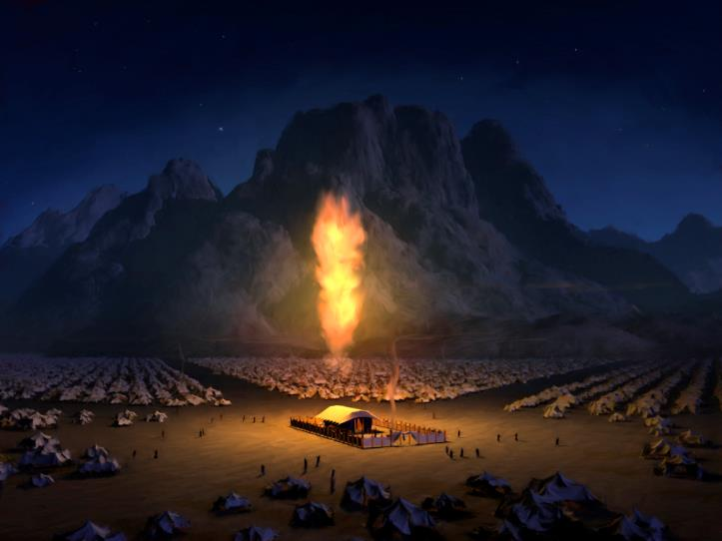
The Presence of God
“with us”

Slide 5
Genesis 1:1-2
In the beginning God created the heavens and the earth. 2 Now the earth was formless and empty, darkness was over the surface of the deep, and the Spirit of God was hovering over the waters.

Slide 6
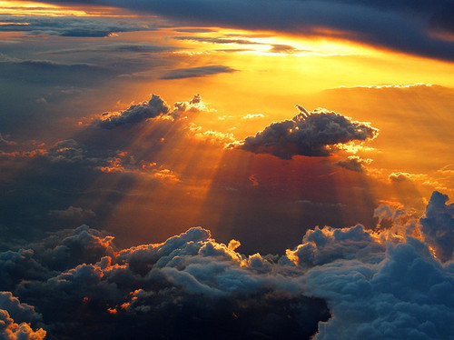

Slide 7
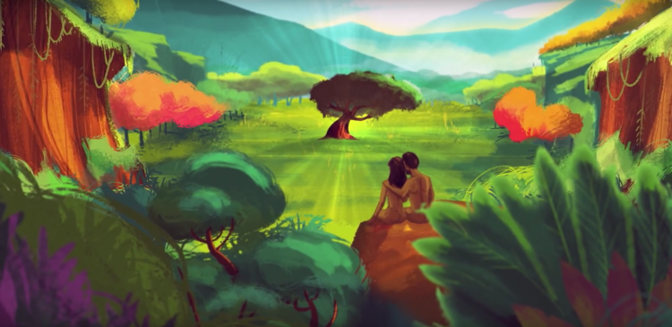

Slide 8
The First 4 Commandments:
Take a day off once a week
Take care of the planet
Have lots of kids
Don't eat from that tree!

Slide 9
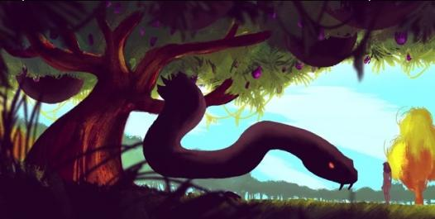

Slide 10
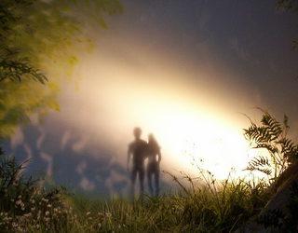

Slide 11
A Promise
&
A Sacrifice

Slide 12
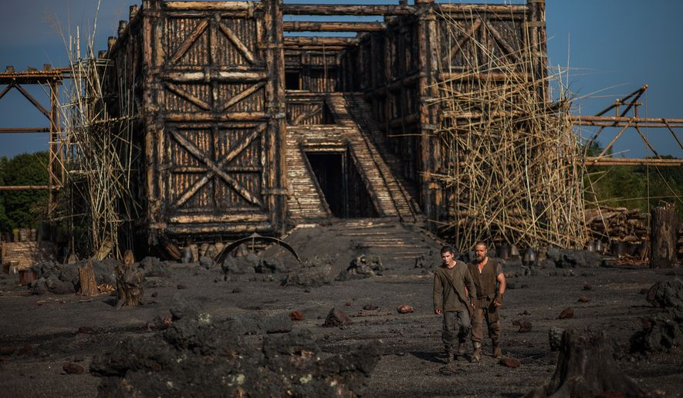
NOAH

Slide 13
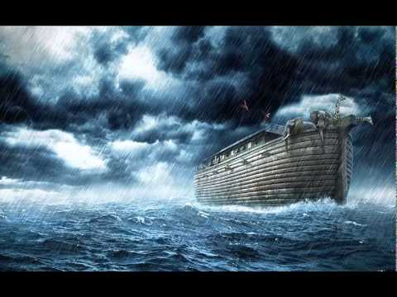

Slide 14
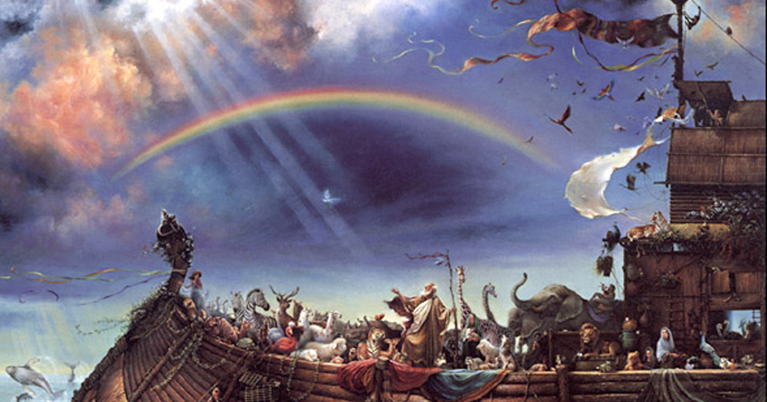

Slide 15
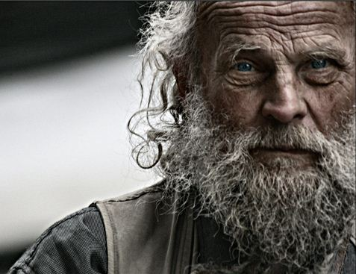
ABRAHAM

Slide 16
Genesis 12:1-3
1 YHWH had said to Abram, “Go from your country, your people and your father’s household to the land I will show you. 2 “I will make you into a great nation, and I will bless you; I will make your name great, and you will be a blessing. 3 I will bless those who bless you, and whoever curses you I will curse;
and all peoples on earth will be blessed through you.”

Slide 17
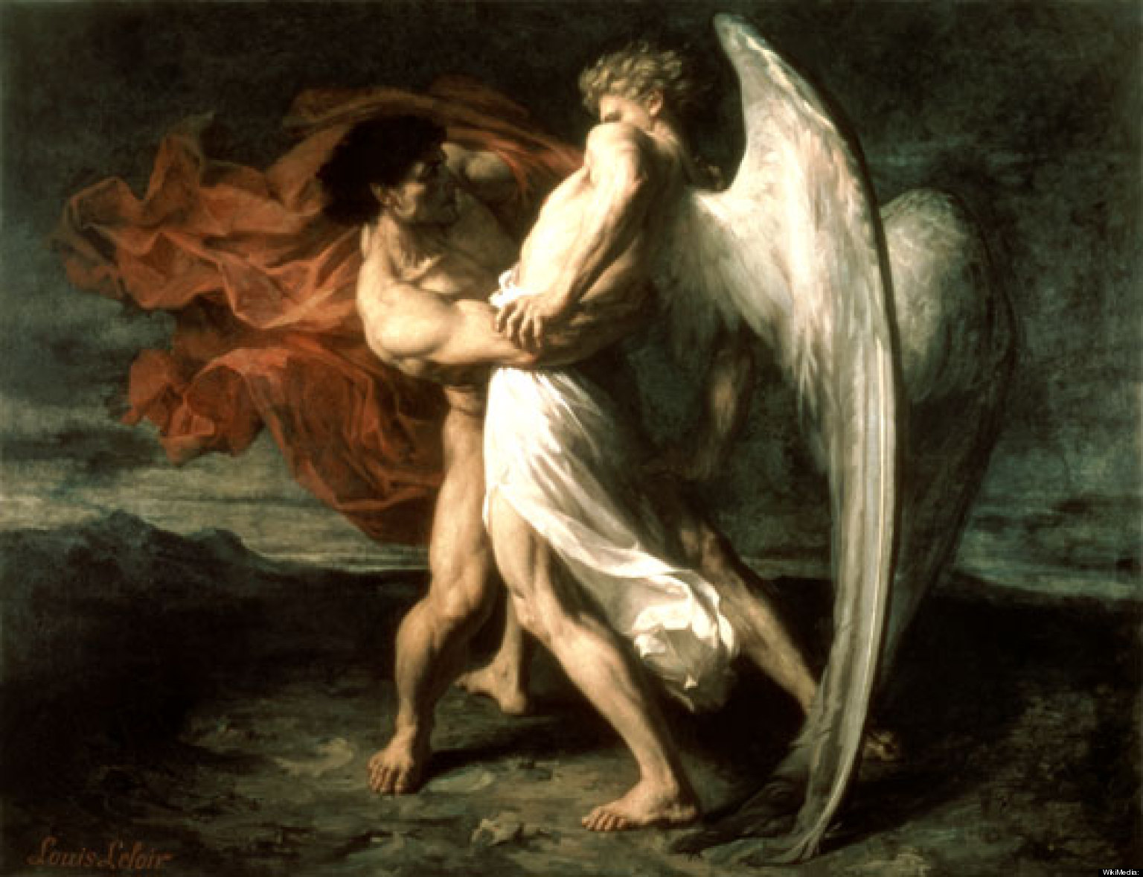
JACOB

Slide 18
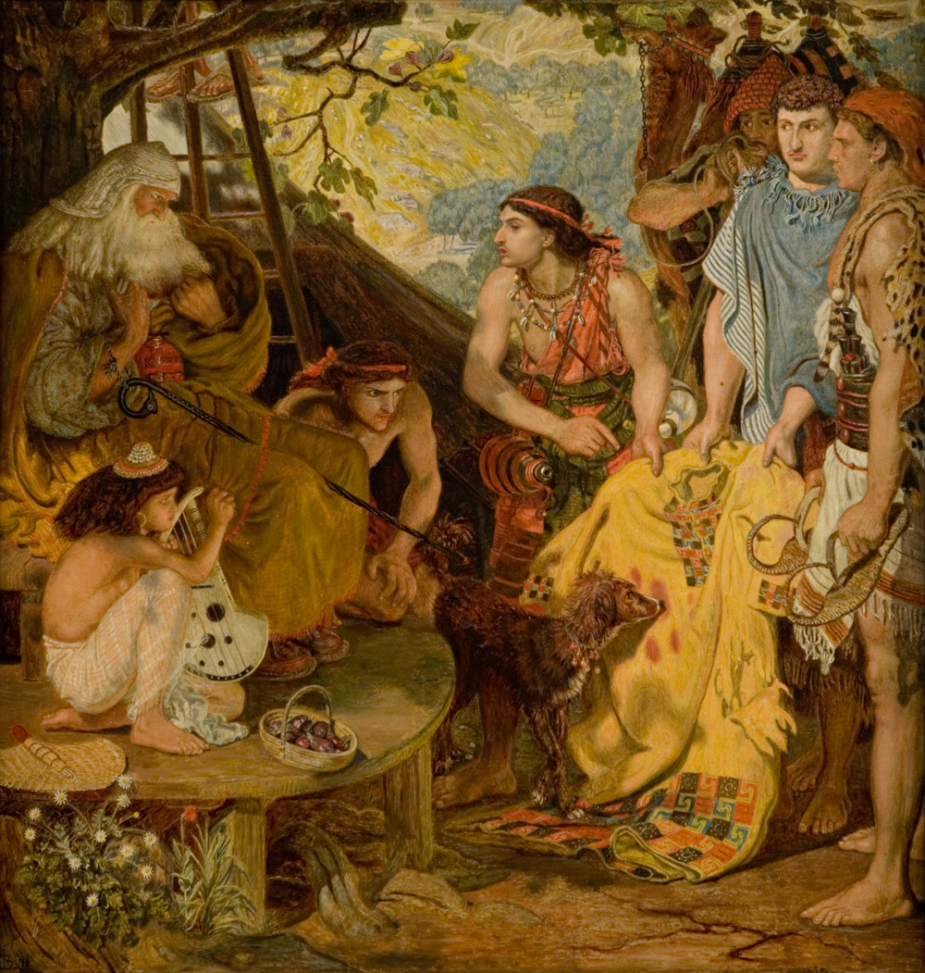
JOSEPH

Slide 19
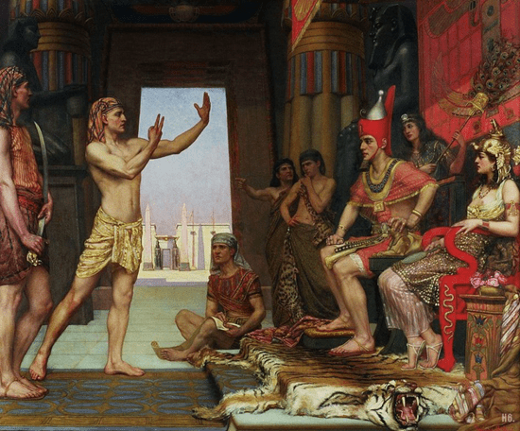
JOSEPH

Slide 20
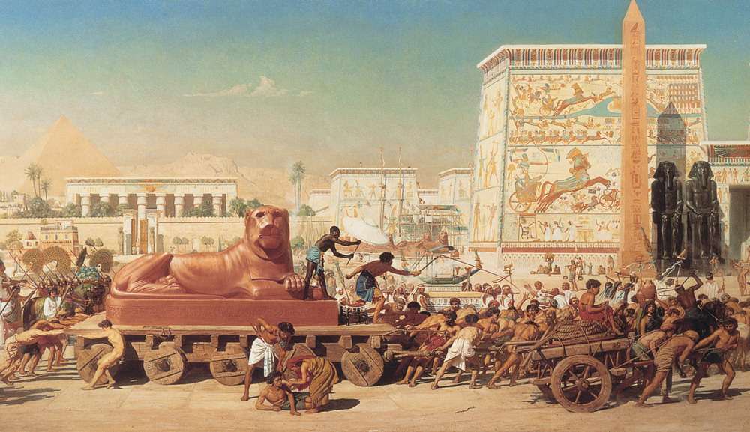
EGYPT

Slide 21
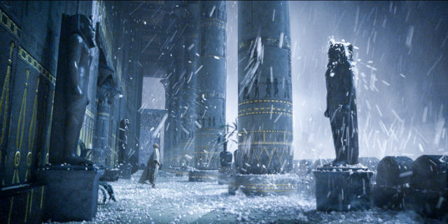
JUDGMENT
On the Egyptian gods

Slide 22
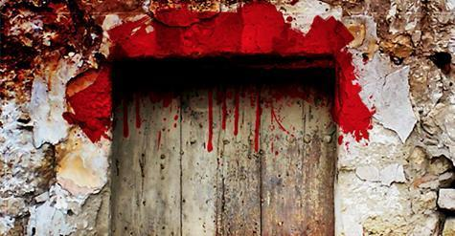
DELIVERANCE
Through the blood of the lamb

Slide 23
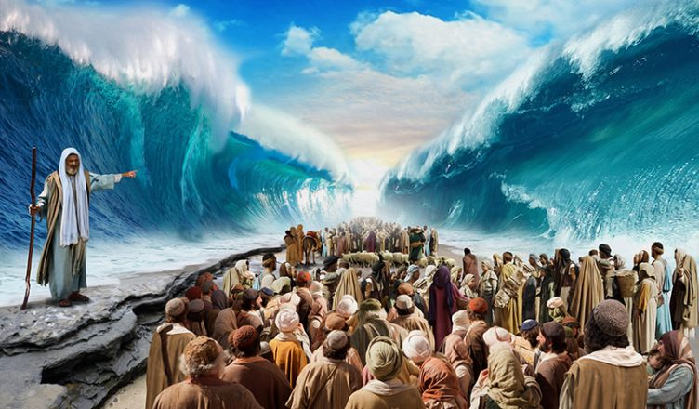
DELIVERANCE
@ the Red Sea

Slide 24
GOD‘S PRESENCE
@ the Tabernacle

Slide 25
Presence= SHKNh (SHeKiNah)
Tabernacle = mSHKN (miSHKaN)

Slide 26
Presence= SHKNh (SHeKiNah)
Tabernacle = mSHKN (miSHKaN)
Neighbor = SHKN (SHaKeN)

Slide 27
John 1:14
The Word became flesh and made his tabernacle among us. We have seen his glory, the glory of the one and only Son, who came from the Father, full of grace and truth.

Slide 28
John 1:14
The Word became flesh and made his tabernacle among us. We have seen his glory, the glory of the one and only Son, who came from the Father, full of grace and truth.
John 1:14 CJB
The Word became a human being and lived with us,
and we saw his Sh’khinah,
the Sh’khinah of the Father’s only Son,
full of grace and truth.

Slide 29
Matthew 28:20
And surely
I am with you always,
to the very end of the age.

Slide 30
NOW
WHAT?

Slide 31
7

Slide 32
Communion
1st Discipline:
The Lord’s Supper, Eucharist

Slide 33
Proclaiming the Gospel
2nd Discipline:

Slide 34
Reconciliation
(peacemaking)
3rd Discipline:

Slide 35
Being with Children
4th Discipline:

Slide 36
Being with the Least, the Last & the Lost
5th Discipline:

Slide 37
Leading with 5 Gifts
6th Discipline:

Slide 38
KINGDOM
PRAYER
7th Discipline:

Slide 39

Creating Space…
Jesus’ Table among God’s family.
Your Table Who can you invite?
Their Table Where is the Kingdom absent?
BLUEPRINT:
3 Tables of Discipleship/Evangelism

