Slide 1
STUDY OF THE HEBREW EPISTLE
The Believer: Living In a World of Non-Belief – Session 1

Slide 2
The Believer: Living In a World of Non-Belief
Introduction
To understand Hebrews we must gain an understanding of Leviticus (3rd book of the Bible).
The Book of Hebrews is based upon the principles of the Levitical Priesthood.
The first Priests being Ordained by God
The High Priest position going from Moses to Aaron
God giving his approval with fire from heaven upon the altar
Leviticus has the ceremonies…Hebrews has the realities
An extension of the Gospel of Matthew – The Apologetics of Jesus – Defending the reality of Jesus as “THE SON OF GOD AND INSTRUMENT OF OUR SALVATION”

Slide 3
The Believer: Living In a World of Non-Belief
Authorship
Who did not write Hebrews….
Paul
Apollos
Peter

Slide 4
The Believer: Living In a World of Non-Belief
THE ONE AUTHOR WE KNOW FOR SURE….
The Holy Spirit!

Slide 5
The Believer: Living In a World of Non-Belief
The Audience
There are no references to the Non-Jew (Gentile) in the Epistle (Letter or book).
The Problems that we know of between Jews and Gentiles in the Church are not mentioned.
Therefore, this initial (first audience) is a strictly Jewish congregation that was experiencing persecution
The information and the teaching that they receive is important to ALL in Christianity.

Slide 6
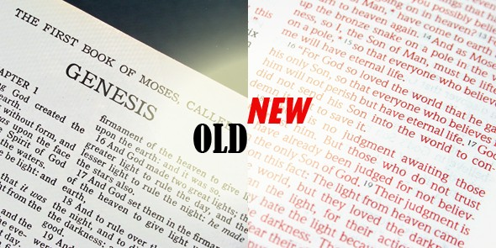
The Believer: Living In a World of Non-Belief
Hebrews shows the church the transition from the Old Covenant to the New Covenant.
From shadows to realities
From accountable actions to accountable thoughts

Slide 7
The Believer: Living In a World of Non-Belief
Location…Location…Location!
Where is this group of Christian-Hebrews Located?
Ephesus? No; Corinth? No; Thessalonica? No
Somewhere near Greece
The Church was organized soon after the ascension of Christ –Acts 1:9-11
At the writing of Hebrews a small congregation was already in place, ready and in need to hear this Word from the Lord!

Slide 8
The Believer: Living In a World of Non-Belief
Chronology – THE TIMELINE of Hebrews
The Letter had been written after Christ’s ascension – AD 30
Before the destruction of Jerusalem and the Temple in AD 70
Possible date of writing – AD 65

Slide 9
The Believer: Living In a World of Non-Belief
Targeted or Intended Groups of the Hebrew Epistle
There are three:
Hebrew Christians
Non-Christians who are intellectually convinced only!
Non-Christians who were not convinced

Slide 10
The Believer: Living In a World of Non-Belief
Some things we may know, but do not know where they come from….
Background Observations that have to be dealt with
God can not be personal – Because no one could see God and LIVE…Based on Exodus 33:20
The thought is since there was no nearness to God there could be no complete forgiveness..only continual sacrifice which only admitted ones guilt.
NOTICE – You did not offer sacrifice to be forgiven, you offered sacrifice because YOU HAD SINNED!

