Slide 1
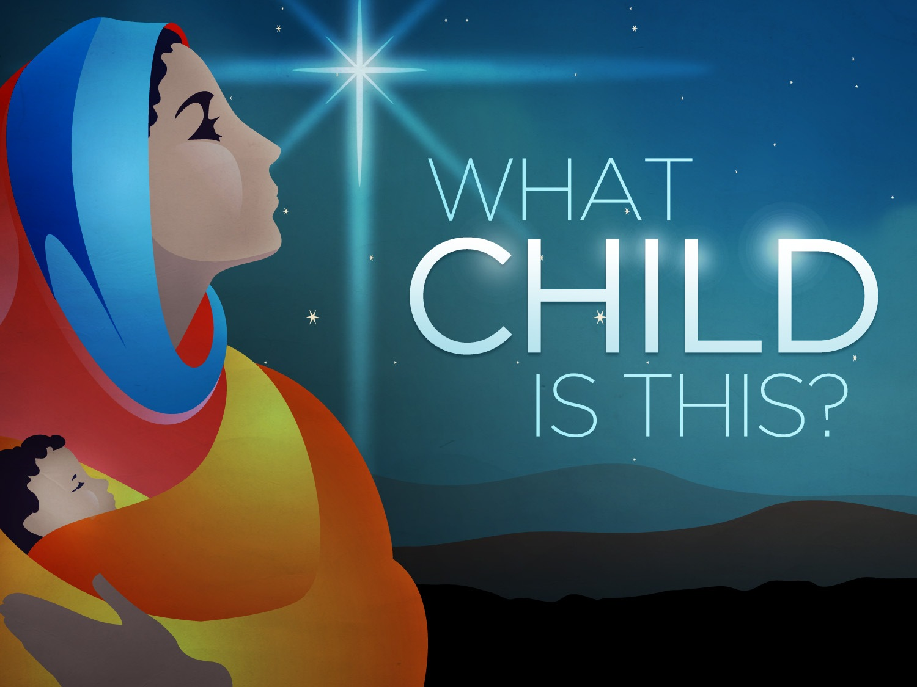

Slide 2
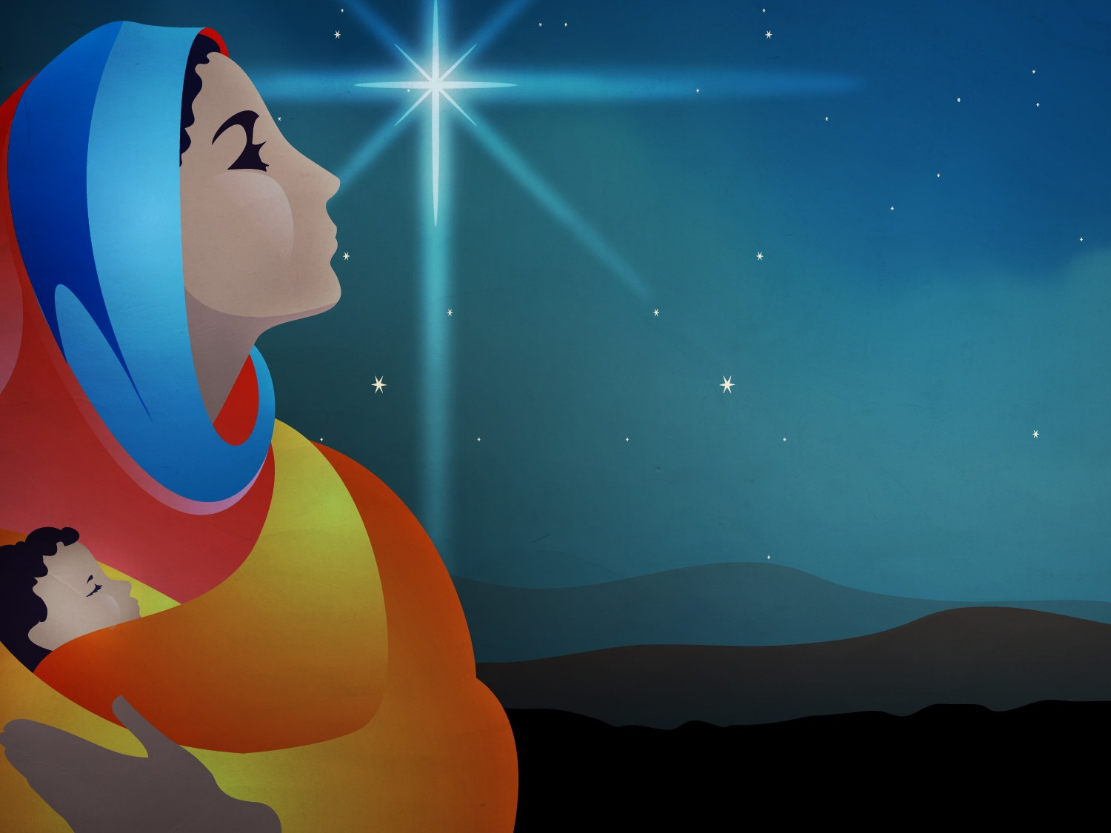

Slide 3
Behold – to observe, look at, see

Slide 4
Hebrew – hinneh (hin-nay’)

Slide 5
Greek – idou (id-oo’)

Slide 6
Lo – See – Behold – Watch Closely

Slide 8
Behold, Jesus: The Baby

Slide 9
Therefore the Lord Himself will give you a sign: Behold, the virgin shall conceive and bear a Son, and shall call His name Immanuel.
-- Isaiah 7:14

Slide 11
For unto us a Child is born, Unto us a Son is given; And the government will be upon His shoulder. And His name will be called Wonderful, Counselor, Mighty God, Everlasting Father, Prince of Peace.
-- Isaiah 9:6

Slide 13
Behold, Jesus: The Lamb of God

Slide 14
The next day John saw Jesus coming toward him, and said, “Behold! The Lamb of God who takes away the sin of the world.
-- John 1:29

Slide 16
“Worthy is the Lamb who was slain To receive power and riches and wisdom, And strength and honor and glory and blessing!”
-- Revelation 5:12

Slide 18
Behold, Jesus: The Man

Slide 19
Then Jesus came out, wearing the crown of thorns and the purple robe. And Pilate said to them, “Behold the Man!”

Slide 20
Therefore, when the chief priests and offers saw Him, they cried out, saying, “Crucify Him, crucify him!”
-- John 19:5-6

Slide 22
But He was wounded for our transgressions, He was bruised for our iniquities; The chastisement for our peace was upon Him, And by His stripes we are healed.

Slide 23
All we like sheep have gone astray; We have turned, every one, to his own way; And the LORD has laid on Him the iniquity of all of us.
-- Isaiah 53:5-6

Slide 25
Behold, Jesus: The Returning King

Slide 26
“And behold, I am coming quickly, and My reward is with Me, to give everyone according to his work.

Slide 27
I am the Alpha and the Omega, the Beginning and the End, the First and the Last.”
-- Revelation 22:12-13

Slide 29
I saw heaven standing open and there before me was a white horse, whose rider is called Faithful and True.

Slide 30
His eyes are like blazing fire, and on his head are many crowns. He has a name written on him that now one knows but he himself.

Slide 31
He is dressed in a robe dipped in blood, and his name is the Word of God.

Slide 32
The armies of heaven were following him, riding on white horses and dressed in fine linen, white and clean.

Slide 33
Out of his mouth comes a sharp sward with which to strike down the nations. “He will rule them with an iron scepter.” He treads the winepress of the fury of the wrath of God Almighty.

Slide 34
On his robe and on his thigh he has this name written: KING OF KINGS AND LORD OF LORDS.
-- Revelation 19:11-16

Slide 36
Behold, Jesus: The Giver of Life

Slide 37
Behold, I stand at the door and knock. If anyone hears My voice and opens the door, I will come in to him and dine with him, and he with Me.

