Slide 1


Psalm 106:6-12 - He saved them from a life of oppression, pried them loose from the grip of the enemy. (MSSG)

Slide 2

PART 1 – “Deadly Drift”

Slide 3

I. Five Reasons for Relational Drift

Slide 4

1. STRESS
1 Peter 5:7 – Give all your worries and cares to God, for he cares about you.

Slide 5

2. SIN & SELFISHNESS
Song of Solomon 2:15 - Catch all the foxes, those little foxes, before they ruin the vineyard of love…

Slide 6

3. SATANIC ASSAULT
John 10:10 - The thief’s purpose is to steal and kill and destroy. My purpose is to give them a rich and satisfying life.

Slide 7

4. UNREALISTIC EXPECTATIONS
Luke 17:1 - Then He said to the disciples, “It is impossible that no offenses should come…”

Slide 8

5. BUSINESS & TIME PRESSURES
Matthew 6:21 – For where your treasure is, there your heart will be also.

Slide 9

II. Three R’s = A Prescription for Relational Health

Slide 10

REFRAME = A. CHOOSE LOVE
John 15:13 – Greater love has no one than this, than to lay down one’s life for his friends.

Slide 11

REFRAME = B. CHOOSE HELP
James 4:6 – God resists the proud, but gives grace to the humble.

Slide 12

RESPOND
A. CONNECTION = Shared experiences build intimacy.

Slide 13

RESPOND
B. CHRONOLOGY = You don’t get quality time without putting in quantity time.

Slide 14
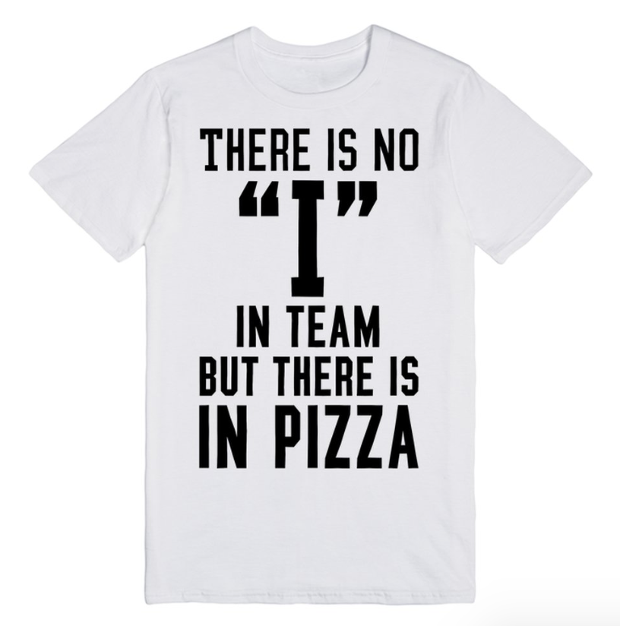
RESPOND
C. CREW = A healthy relationship is about us.

Slide 15

REMEMBER
A. God’s PURPOSE
Genesis 2:18 – And the Lord God said, “It is not good that man should be alone…”

Slide 16

REMEMBER
B. God’s POWER
John 11:43 – Then Jesus shouted, “Lazarus, come out!”

