Slide 1
Developing Vision and Goals
PASTOR Scott Smith
Living Proof Church
Tyrone, GA 30277
770-969-5683

Slide 2
Learning Objectives
The learner will be able to develop vision and goals for both their personal life and their ministry.
The learner will be able to see how their personal vision and goals fit into the organizational vision and goals of Living Proof Church.

Slide 3
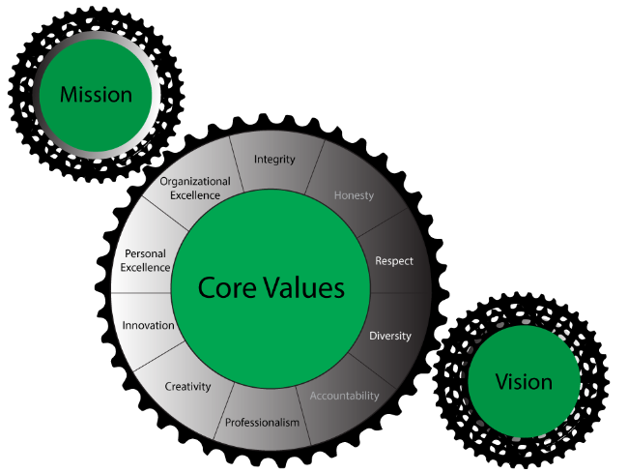

Slide 4
Visionary Leadership
Having a vision of the future for yourself, your team, your division, or your organization — and setting the kind of long-term goals that will get you there — is just the first step in visionary leadership.

Slide 5
Defines the desired or intended future state of an individual or organization
Is a projection of where a person or company wants to be in the future
Long term
Provides a big picture
Matches who we are
Outlines key values; reveals beliefs
Provides inspiration and focus
Can extend beyond one’s own lifetime
Determines direction
Must be kept in front of you
Includes things that are not true now but that the organization is striving to make true
Separates leaders from followers
Indicates what the world will look like after you’ve finished changing it
Without vision = ship without a rudder, drifting without direction

Slide 6
What’s wrong with the world and how you intend to fix it
What you are doing today
Provides purpose
How you will achieve the vision
When you are clear about your mission, goals and operating objectives flow from it

Slide 7
How you are going to get there
An expected or desired outcome of a planning process
Usually broad, general expressions of the guiding principles and aspiration
Goals are short term milestones or bench marks that must be achieved in order for long term objectives to be reached

Slide 8
THE INTERPLAY OF MISSION & GOALS, VALUES, STRATEGIES, & VISION
MISSION & GOALS
“What”
VALUES
“Who”
STRATEGIES
“How”
Alignment
VISION
“Why”

Slide 9
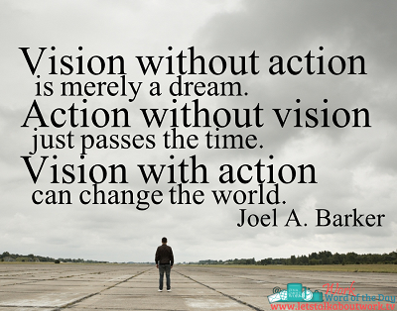

Slide 10
Leaders need a vision that is….
Personal to who they are
Practical for when they live
Possible for what they have
Parallel to who they are
Portable for where they go
Powerful for how they live
Profitable for what they do
Pleasurable for who they are
Purposeful for why they live
Providential for where they are heading

Slide 11
Leaders See….
Beyond Others
Before Others
Bigger Than Others

Slide 12
Great Leaders Never Loose Sight Of The Big Picture

Slide 13
Great Leaders See The Value Of Today

Slide 14
“Shoot for the moon! Even if you miss, you’ll still be among the stars.” Les Brown

Slide 15
Vision Statement
A vivid idealized description of a desired outcome that inspires, energizes
and helps to create a mental picture of one’s target
Creates a mental picture charged with emotion that can serve to energize and inspire you and your team
Based on the best possible outcome
Opens your eyes to what is possible
Described in the present tense
Describes what will be achieved once success is reached

Slide 16
Great Questions for Every Leader in Developing Vision and Goals
What would you do if you had no fear of failure?
What burdens drive you to become passionate?
What causes you to rejoice?

Slide 17
How will you respond to what you see?

Slide 18
Practical Steps
Set aside some time to sit with god
Review your goals and values
Make appointments with people who possess the qualities you want to assume
Surround yourself with people different from you
Write it down
Keep it visible
Review regularly

Slide 19
STAY THE COURSE! FINISH STRONG!

Slide 20
RESOURCES
How Successful People Think, John C. Maxwell
The Principle of the Path, Andy Stanley
21 Irrefutable Laws of Leadership, John C. Maxwell
What They Don’t Teach You in the Harvard Business School, Mark McCormack

Slide 21
FOR FUTHER STUDY
Personality Profiles
DISC
Meyer’s Briggs

