Slide 1



Slide 2
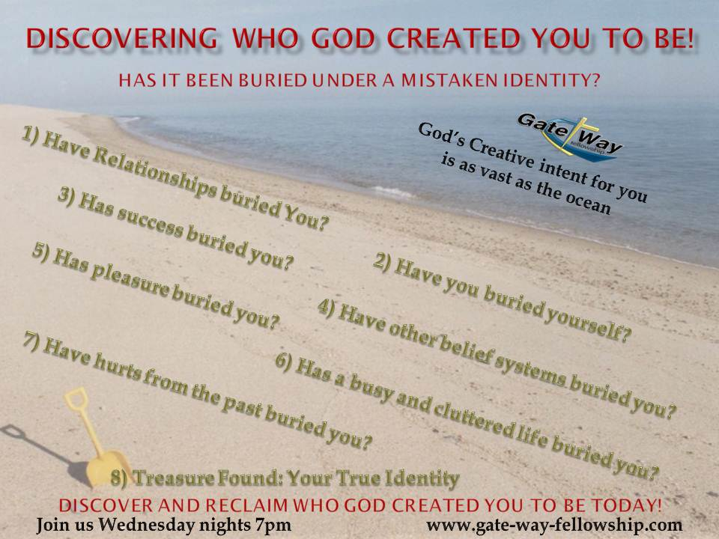

Slide 3
Exodus is about the redemption of the people from captivity
Leviticus is about the people learning how to approach God
and have
fellowship with Him

Slide 4
Leviticus
Access to God is only through blood,
and once access is gained
It then call for holiness on the part of the worshiper.

Slide 5
1 Peter 2:5
“you yourselves like living stones are being built up as a spiritual house, to be a holy priesthood, to offer spiritual sacrifices acceptable to God through Jesus Christ.”

Slide 6
5 Offerings in Leviticus Ch. 1-7
Voluntary Offerings
1) Burnt 2) Meal 3) Peace
Compulsory Offerings
4) Sin 5) Trespass

Slide 7
Leviticus 4-5
Sin
&
Trespass
Offerings

Slide 8
Psalm 32:1
“Blessed is the one whose transgression is forgiven, whose sin is covered.”

Slide 9
Sin Offering
Leviticus 4:22-24
“When a leader sins,
…..
And shall lay his hand on the head of the goat and kill it in the place where they kill the burnt offering before the Lord; it is a sin offering.”

Slide 10
Trespass Offering
Leviticus 5:12-13
“and he shall bring it to the priest,
…..
For it is a sin offering. Thus the priest shall make atonement for him for the sin which he has committed in any one of these things, and he shall be forgiven.”

Slide 11
Sin Offering
Must be atoned for by the Sinner
For us in the new covenant:
Jesus has already done this
He took our place as the sinner
And has made atonement for us!!!!

Slide 12
Trespass Offering
For Sin
after the Sin Offering has been accepted.
Christ is now our high priest at the right hand of the Father.

Slide 13
Sin Offering
For:
Times when Restitution is impossible

Slide 14
Sin Offering
Leviticus 4:6
“and the priest shall dip his finger in the blood and sprinkle part of the blood seven times before the Lord in front of the veil of the sanctuary.”

Slide 15
Sin Offering
Provision for:
Intentional Sins
Unintentional Sins
Sins of Omission
Sings of Commission
All Sin must be Atoned for

Slide 16
Sin Offering
Leviticus 4:12
“he shall carry outside the camp”
Hebrews 13:11-12
“Jesus also suffered outside the gate in order to sanctify the people through His own blood.”

Slide 17
Trespass Offering
Why is the first called a
Sin offering
And this one is called a
Trespass Offering

Slide 18
Trespass
Proverbs 3:23
“Then you will walk on your way securely, and your foot will not stumble.”

Slide 19
Trespass
Leviticus Ch 5
You are guilty if:
Aware of sin and doing nothing
Do anything unclean
Make a rash oath
Commit a breach of faith
Do anything that by the Lord’s commandments ought not to be done…

Slide 20
All of these
Trespasses
block our Anointing
from the Lord

Slide 21
1 John 1:7-9
“But if we walk in the light as He is in the light, we have fellowship with one another, and the blood of Jesus His Son cleanses us from all sin.
…
If we confess our sins, He is faithful and just to forgive us our sins and to cleanse us from all unrighteousness.”

Slide 22
Leviticus 5:5
“when he realizes his guilt in any of these and confesses the sin he has committed,”

Slide 23
Leviticus 5:5,10
5“confesses the sin”
10“And the priest shall make atonement for him for the sin that he has committed, and
he shall be forgiven.”
Repeated 9 Times

