Slide 1
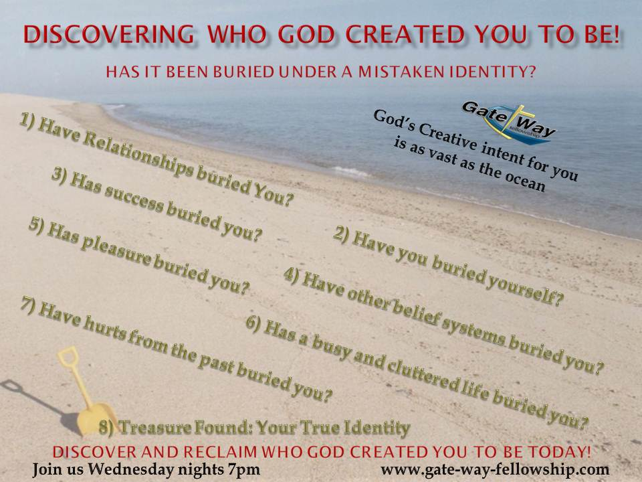

Slide 3
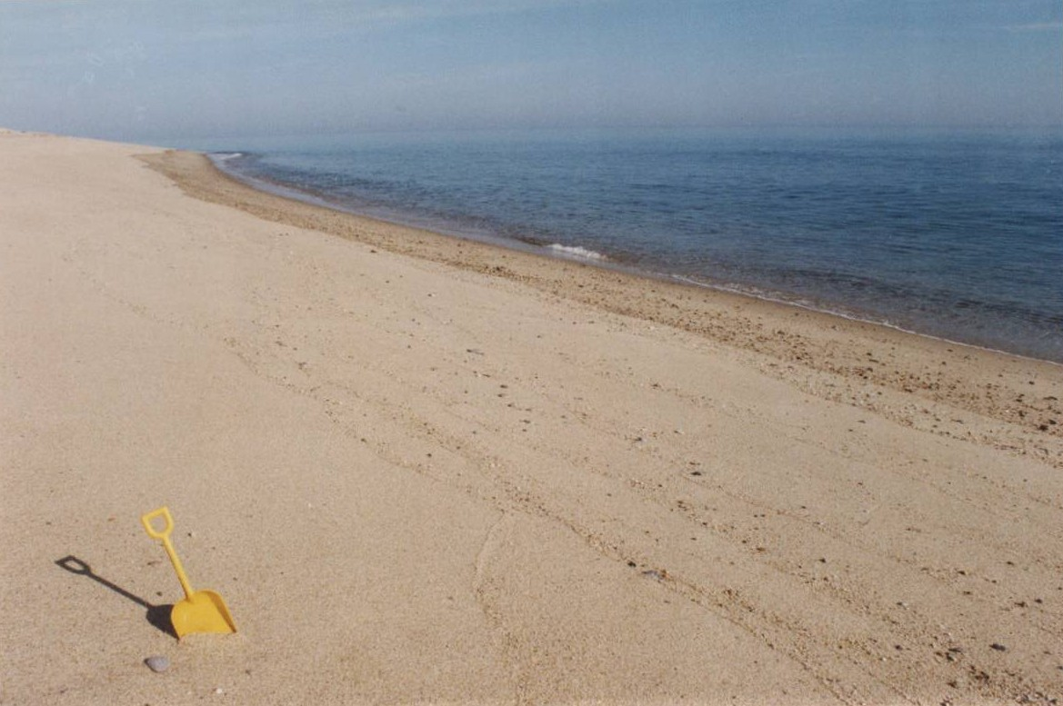
Have relationships buried You?
Your best friend
is not a Christian

Slide 4
Have relationships buried You?
Others have treated you poorly
And told you bad things about
Who you are

Slide 5
Have relationships buried You?
Fear of Relationships

Slide 6
Have relationships buried You?
Seeking the
Perfect Relationship

Slide 7
Seeking the Perfect Relationship
Romance
(1828 Webster Dictionary)
Fictitious
To forge and tell fictitious stories
Romancer: One who invents fictitious stories
Romancing: Inventing and telling fictitious tales
Building castles in the air.
The Perfect relationship is fictitious

Slide 8
What Relationships really want
Proverbs 19:22
“What a person desires is
Unfailing love;”

Slide 9
“What a person desires is
Unfailing love”
When we don’t get it:
Job 5:2
“Resentment kills a fool
and envy slays the simple”

Slide 10
“What a person desires is
Unfailing love”
When we don’t get it:
Job 18:4
“You who tear yourself
to pieces in your anger”

Slide 11
Grudges and Bitterness
Bury who God Created us to be

Slide 12
Bitterness destroys
Gods creative intent for You
Makes us Blind - 1 John 2:9-11
Ruins our prayer lives - Mark 11:15
Undermines our good relationship -Hebrews 12:15
Imprisons us - Matthew 18:21-35
Lessons ability to enjoy worship of – Matt 5:23-24

Slide 13
There is NO benefit to having
Bitterness in your life
But there is tremendous cost!

Slide 14
Bitterness destroys our
Physical health
Job 21:23-25
“One man dies in full vigor
Completely secure and at ease,
His body well nourished,
His bones rich with marrow,
Another man dies in bitterness of soul
Never having enjoyed anything good”

Slide 15
Don’t let these things
Define who you are anymore
Choose to forgive

Slide 16
“Unfailing Love”

Slide 17
“Unfailing Love”
Psalm 32:10
“Unfailing love surrounds those who trust in the Lord”

Slide 18
“Unfailing Love”
Psalm 33:5
“The Lord loves righteousness and justice; the earth is full of His unfailing love.”

Slide 19
“Unfailing Love”
Psalm 130:7
“Hope in the Lord; for with the Lord there is unfailing love and overflowing supply of salvation.”

Slide 20
“Unfailing Love”
Psalm 17:7-8
“Show me your unfailing love in wonderful ways. You save with Your strength those who seek refuge from their enemies. Guard me as the apple of your eye. Hide me in the shadow of your wings.”

Slide 21
“Unfailing Love”
All 40 times the phrase is used
He is the source of
Unfailing Love

Slide 22
“Unfailing Love”
1 John 3:1
“see what great love the Father has lavished on us, that we should be called children of God! And that is what we are!”

Slide 23
Discovering who God Created You to Be
Define yourself as
Someone who is radically loved by God

