Slide 1
VBS 2017

Slide 2
VBS 2017 Verse
“Let your light so shine before men, that they may see your good works, and glorify your Father which is in heaven.”
Matthew 5:16 (KJV)

Slide 3
VBS 2017 Verse
“Let your light so shine before men, that they may see your good works, and glorify your Father which is in heaven.”
Matthew 5:16 (KJV)

Slide 4
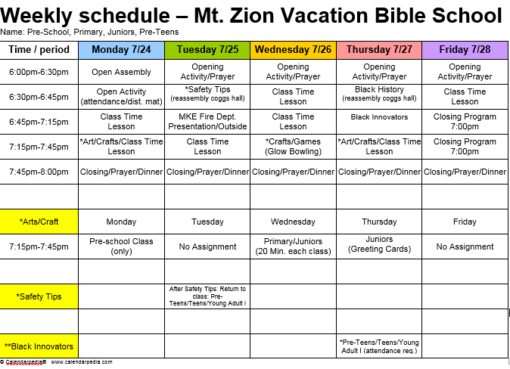

Slide 5
Milwaukee Fire Dept. Visits VBS

Slide 6
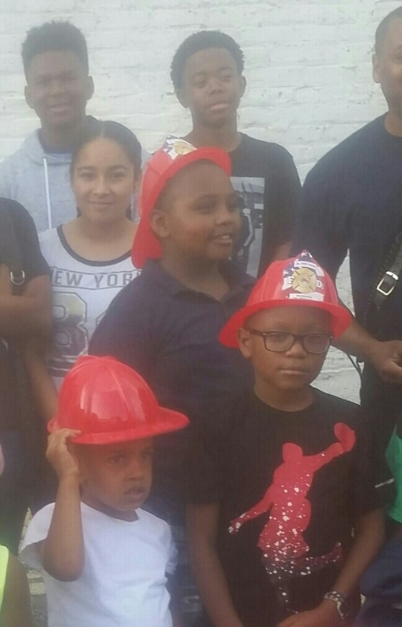
Junior Fire Fighters

Slide 7
Honorary Fire Chief

Slide 8
In Training

Slide 9
Waiting For Instruction

Slide 10
Whoa !

Slide 11
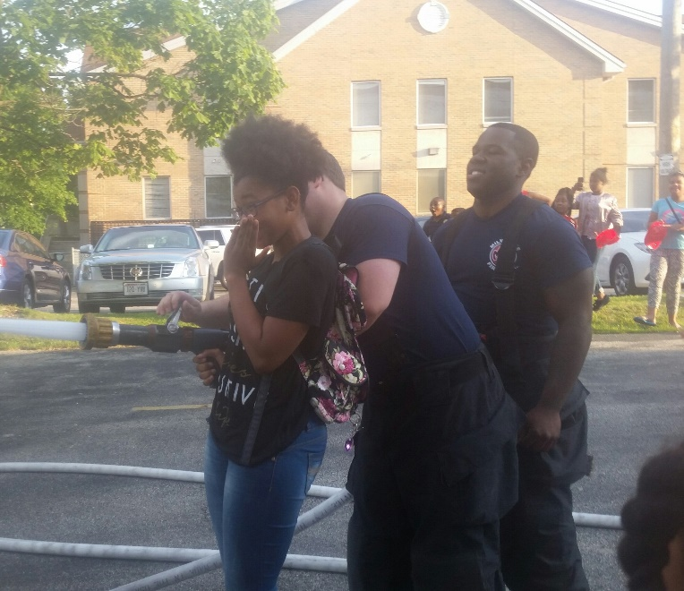
When All Else Fails……

Slide 12
Fight Fire With Style

Slide 13
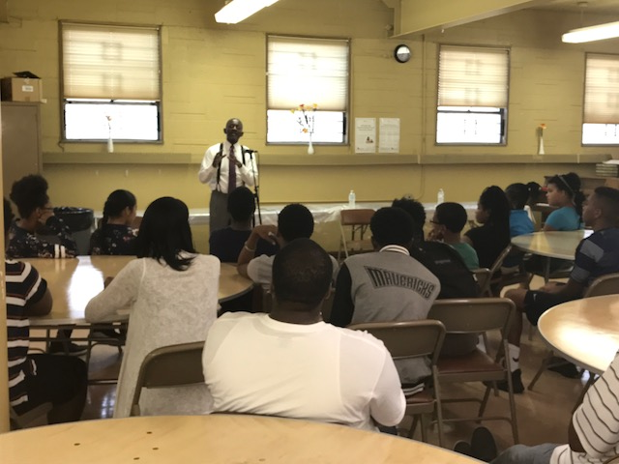
Mt. Zion VBS 2017
VBSTALKS
Principles to spread and ignite

Slide 14
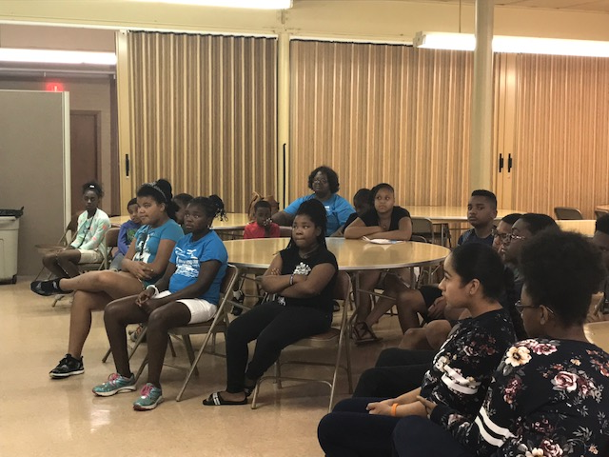
Judges Carl Ashley and Joseph Donald
VBSTALKS
Principles to spread and ignite
Black Innovators Series

Slide 15
Judges Conduct Seminar in Coggs Hall
VBSTALKS
Principles to spread and ignite
Black Innovators Series

Slide 16
VBS Students and Judges
VBSTALKS
Principles to spread and ignite
Black Innovators Series

Slide 17
VBS Directors and Students Thank the Judges
VBSTALKS
Principles to spread and ignite
Black Innovators Series

Slide 18
VBS Classes

Slide 19
Pre-School VBS Class

Slide 20
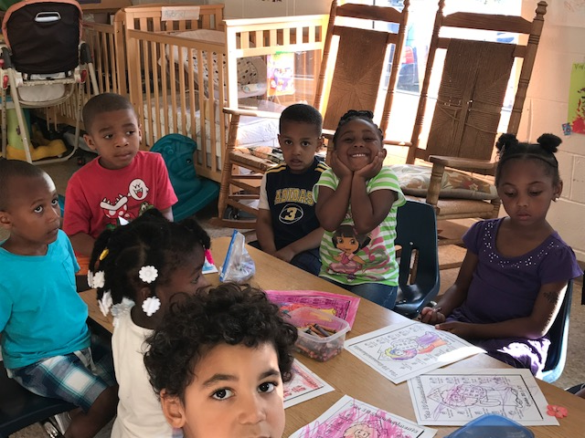
Pre-School VBS Class

Slide 21
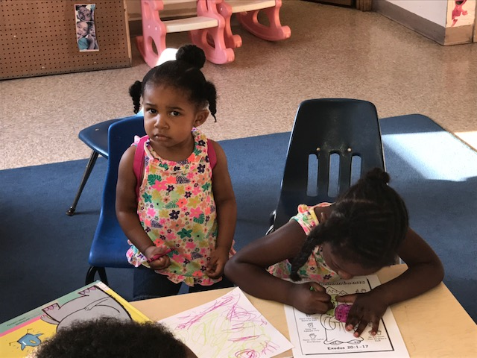
Of Course My VBS Artwork is Perfection

Slide 22
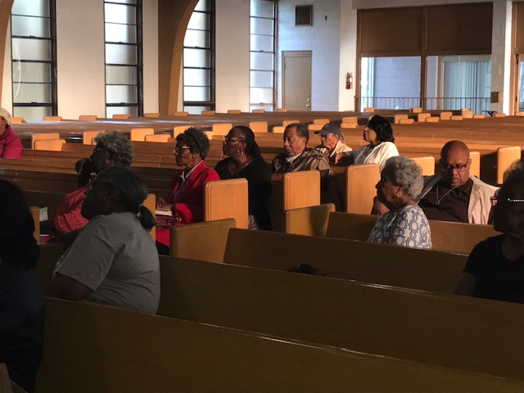
VBS Adults

Slide 23
VBS Adult Session

Slide 24
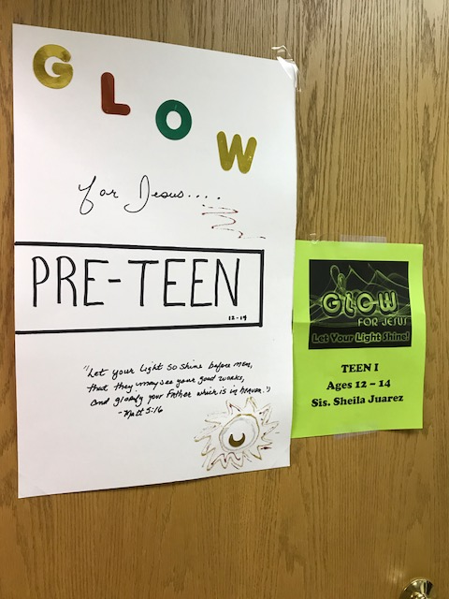
Pre-Teens Glow For Jesus

Slide 25
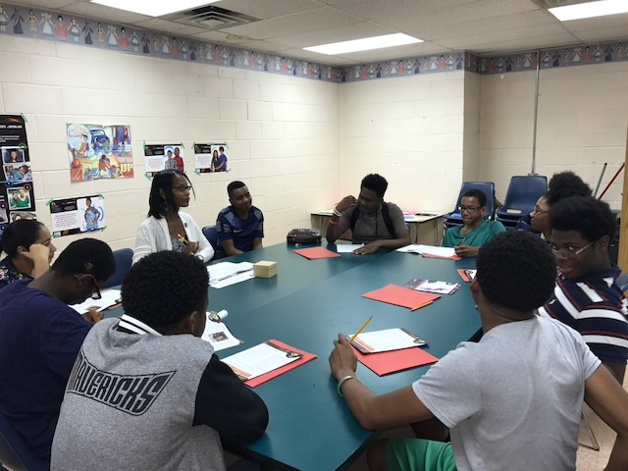
Sister Shelia Juarez Puts Out a Spiritual Challenge

Slide 26
…We’re Ready

Slide 27
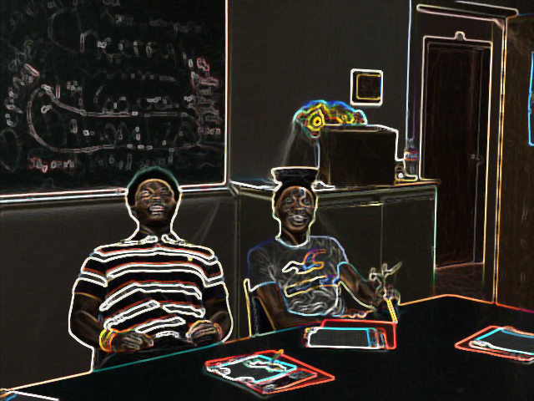
For That Challenge Ms. Juarez!

Slide 28
Arts, Crafts, Games

Slide 29
Prepping for the Crafts

Slide 30
Pink Was A Favorite Color

Slide 31
I Got This…

Slide 32
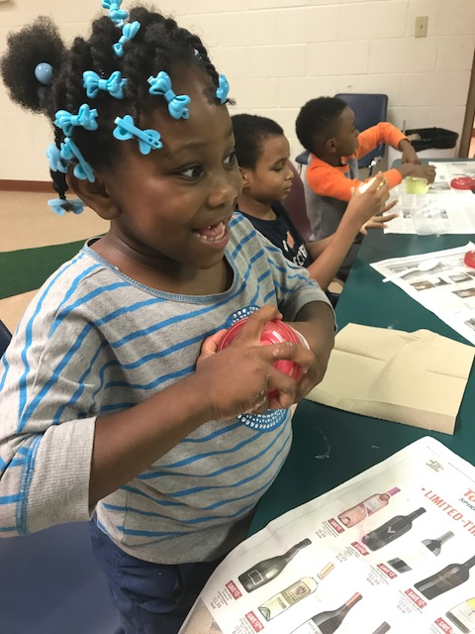
VBS Interactive Crafts

Slide 33
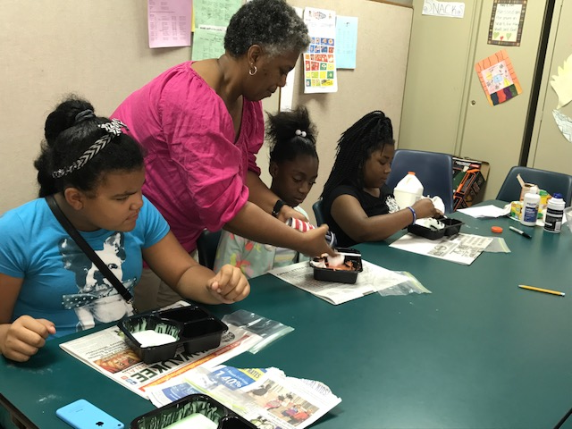
The Instructions…..

Slide 34
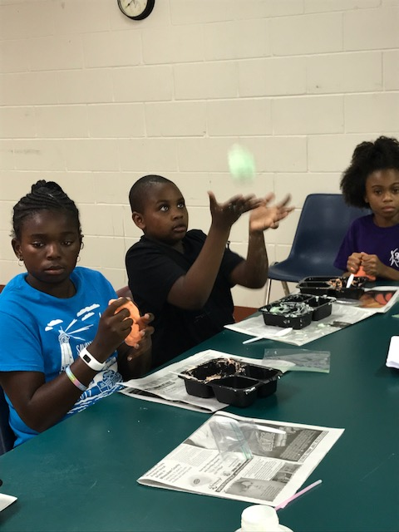
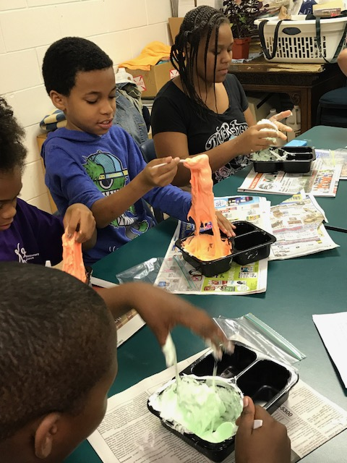
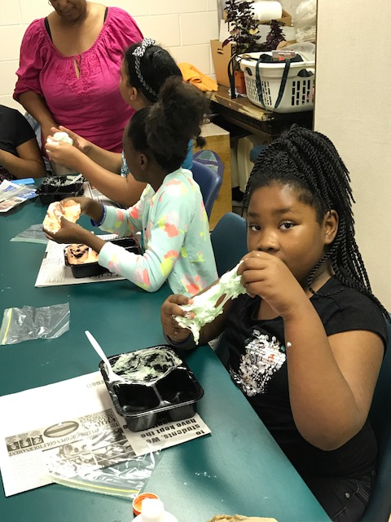
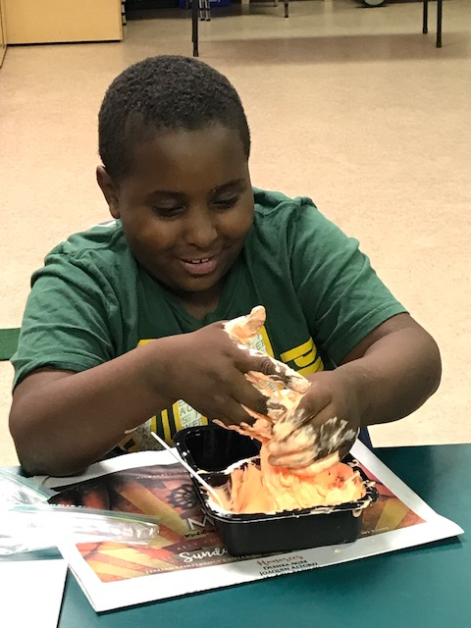
It’s All Hands On

Slide 35
For Making Glow-in-the-Dark SLIME!

Slide 36
For Making Glow-in-the-Dark SLIME!

Slide 37
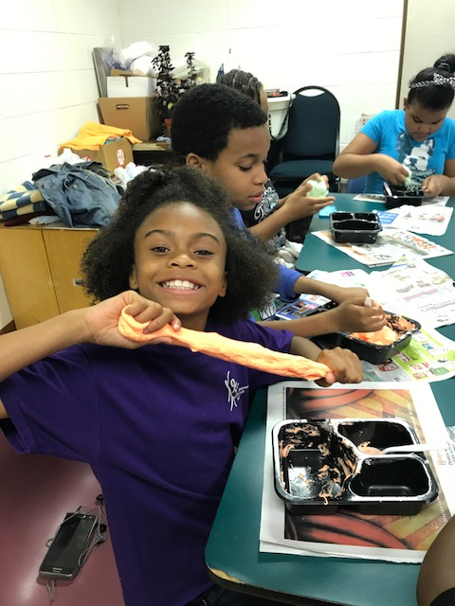
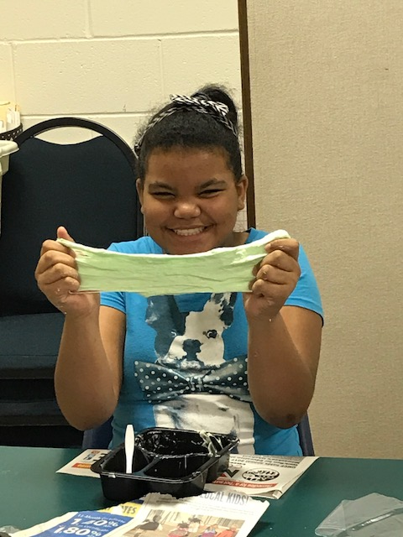
Smiles Stretch

Slide 38
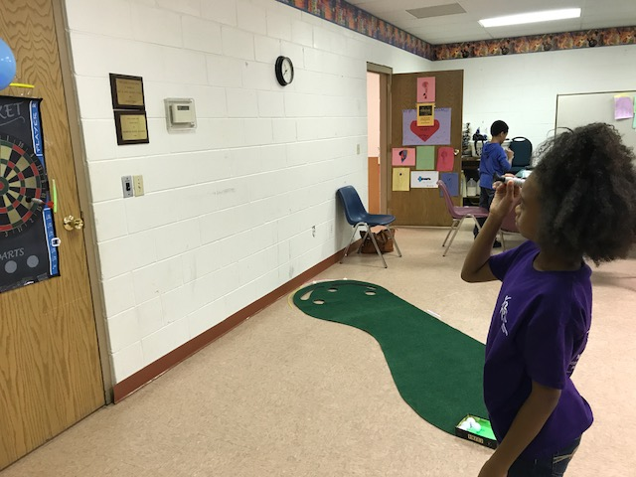
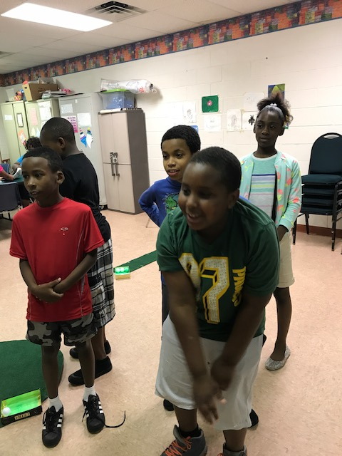
VBS Games: Crickets & Mini Golf

Slide 39
Putting Takes Precision and Action

Slide 40
VBS Theme 2017
We are the are the light of the world and God intends for us to do good in the world. Jesus saved us to shine.
VBS challenged us to do something—and that is to glow for Jesus through our actions.

Slide 41
VBS Theme 2017
We are the are the light of the world and God intends for us to do good in the world. Jesus saved us to shine.
VBS challenged us to do something—and that is to glow for Jesus through our actions.

Slide 42
Thank you for attending
VBS 2017

Slide 43
Thank you for attending
VBS 2017

