Slide 1
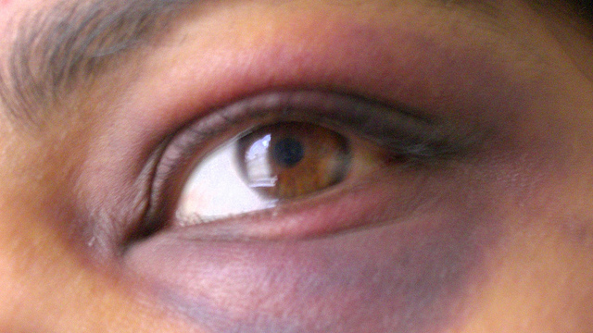
Intimate Partner Violence

Slide 2
Statistics
86/14 Male and female abusers
75% Teens who know someone who is being abused
27% African-American women who die due to domestic
violence in Oklahoma County

Slide 3
Love Does Not Hurt!
It is abuse when a person uses fear and/or intimidation to control another person’s behavior to:
Keep a person from doing something she/he wants to do
Make a person do something she/he does not want to do

Slide 4
Abuse Takes Several Forms
Verbal
Physical
Sexual
Economic
Psychological
When a person instills fear and/or intimidation to get a person to do something she/he does not want to do;
or
When a person instills fear and/or intimidation to get a person not to do something he/she wants to do.

Slide 5
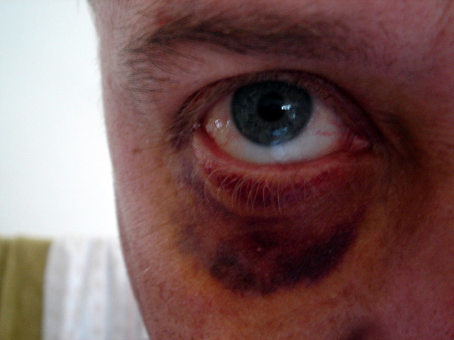
Love Does Not Hurt

Slide 7
If you see something, say something.
To talk to someone and/or to get help call:
922-YWCA (local)
National Domestic Violence Hotline 1-800-799-7233

