Slide 1

Revealing the REAL Jesus
An Epiphany Journey

Slide 2
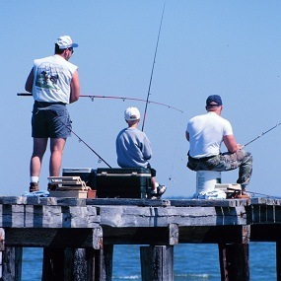
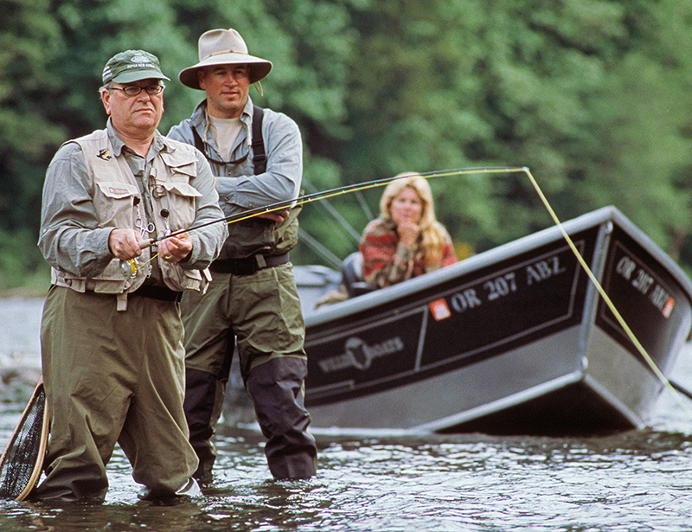
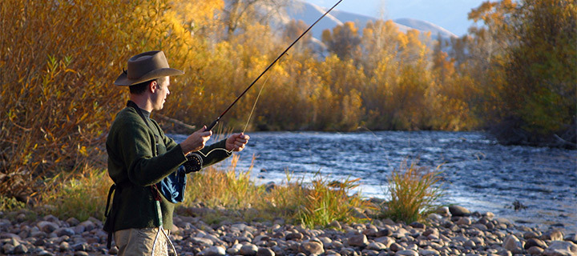
“Gone fishing”

Slide 3

Jesus went “fishing” (vs.14,15)

Slide 4
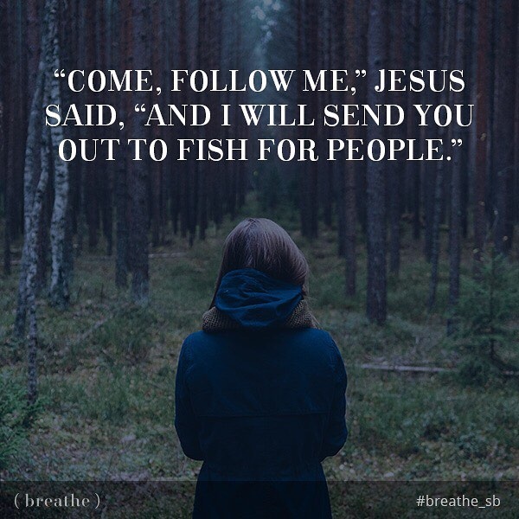
Fishers of people (vs.16,17)

Slide 5
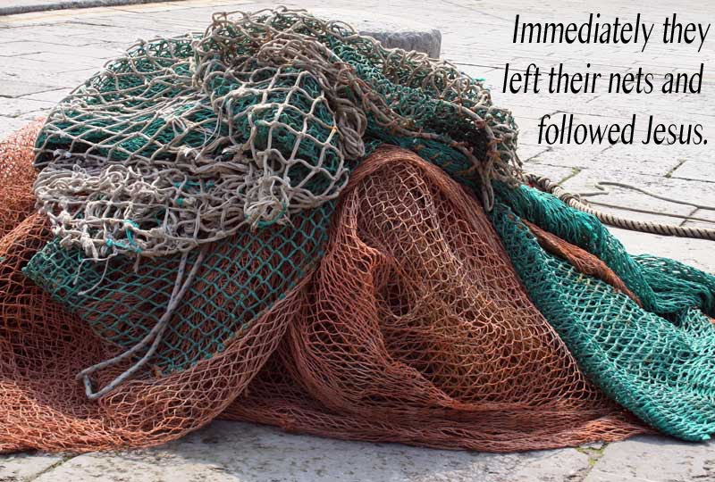
“Immediately …” (vs.18,20)

Slide 6

“… God relented…” (Jonah 3:10)

Slide 7

The REAL Jesus loves fishing

